Slide 1

LABORATORY No 8
Logic operation of AND, OR, XOR, and NOT

Slide 2
Menu done in Example 8.1 for 16-bits logic bitwise manipulation
A. AND (&) operation (16-bit).
B. OR (|) operation (16-bit).
C. XOR (^) operation (16-bit).
D. NOT (~) operation (16-bit).

Slide 3
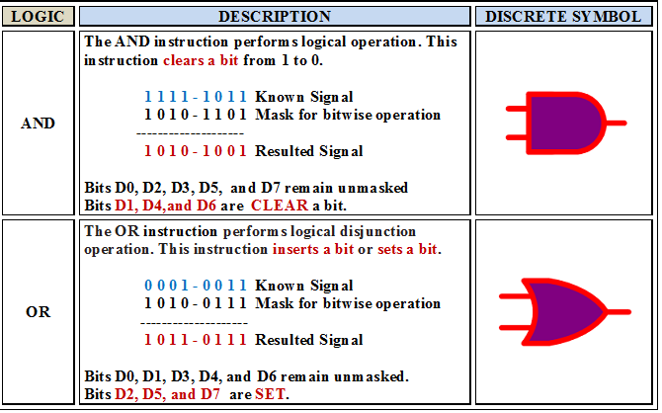

Slide 4
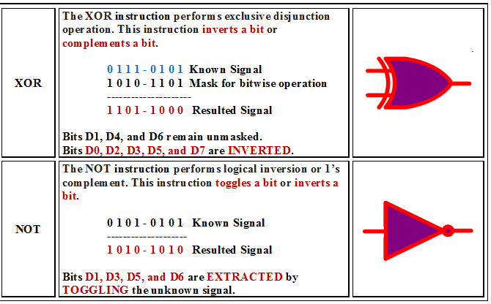

Slide 5
LOGIC OPERATIONS TO MANIPULATE BITS
Next, in Example 8.1 menu for 16-bits logic manipulation.
A. AND (&) operation (16-bit).
B. OR (|) operation (16-bit).
C. XOR (^) operation (16-bit).
D. NOT (~) operation (16-bit).
EXAMPLE 8.1

Slide 6
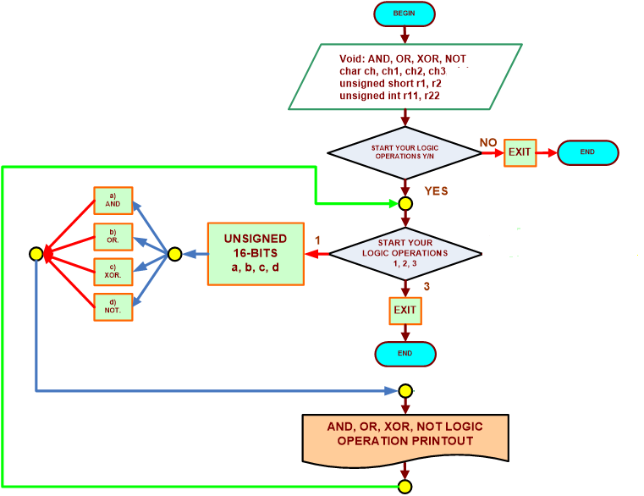
FLOWCHART FOR THE EXAMPLE 8.1 UNSIGNED

Slide 7
STUDENTS’S ASSIGNMENT
FOR LABORTORY 8.1 UNSIGNED NUMBER
The students should get EIGHT console output result operations for unsigned value.
One for AND Logic 16-bits 12ae, ff00
One for OR Logic 16-bits 12ae, ff00
One for XOR Logic 16-bits 12ae, ff00
One for NOT Logic 16-bits 12ae, ff00
Total of 1 outputs

Slide 8


Slide 9
Thanks

